Slide 1

XNA 3D Primer
Michael C. Neel
ViNull.com
michael.neel@gmail.com

Slide 2
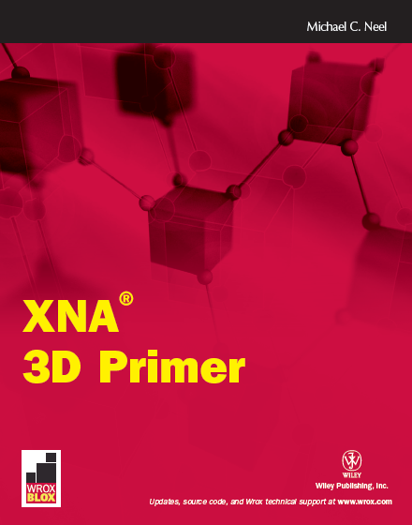
Wrox.com

Slide 3

create.msdn.com
vinull.com

Slide 4
3D Overview

Slide 5

3D Math
Decimals, Doubles, and Floats, Oh My!
Notes:
http://www.flickr.com/photos/theatrebhs/5610503771/
Decimal vs Float memory storage
Decimal vs Float precision

Slide 6

3D Math
Right Hand Rule
Notes:
http://www.flickr.com/photos/rutty/492385781/
Axis Direction and Rotation

Slide 7

3D Math
Matrix.CreateScale
Matrix.CreateRotationX
Matrix.CreateRotationY
Matrix.CreateRotationZ
Matrix.CreateFromAxisAngle
Matrix.CreateFromQuaternion
Matrix.CreateTranslation
Matrix.CreateLookAt
Matrix.CreatePerspective
Matrix.CreatePerspectiveFieldOfView
Matrix.CreatePerspectiveOffCenter
Matrix.CreateOrthographic
Matrix.CreateOrthographicOffCenter
Matrix.CreateWorld
Notes:
http://www.flickr.com/photos/rutty/492385781/
4x4
Multiple to Combine

Slide 8
3D Math
Identity
Scale
Rotate
Orbit
Translate
ISROT
Notes:
Http://www.flickr.com/photos/rutty/492385781/
All translations take place from 0, 0, 0

Slide 9
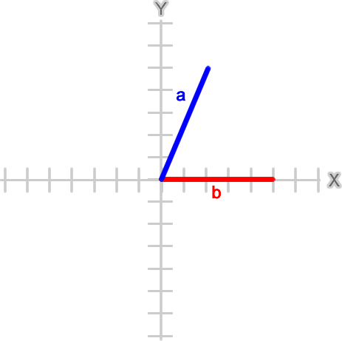
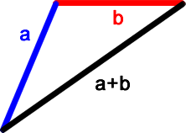
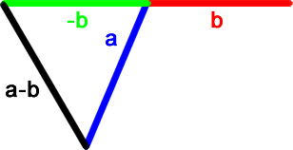
3D Math - Vectors
Notes:
http://www.flickr.com/photos/rutty/492385781/
Vectors start from 0, 0, 0
Adding with Head to Tail Rule: vector b head at vector a tail
Subtract by adding inverse of the second
Use in game: vector a is the player, vector b is the robot, and a+b is the trajectory of the laser
Subtraction is useful for collision – a and b are pool balls, if a-b length is less than the sum of the balls’ radii they have hit (aka bounding sphere)
Scale a vector by *

Slide 10
3D Math – Build a better Arc
Arctangent2 – Math.Atan2
Math.Atan2( 2.0, 4.0)
0.46364760900080609
Math.Atan2( -2.0, -4.0)
-2.677945044588987
Notes:
http://www.flickr.com/photos/rutty/492385781/
Arc tangent gives the inverse of tangent, and gives the angle of the of the hypotenuse given the ratio of the legs. 2, 4 and -2, -4 have the same ratio (.5) so you must figure the quadrant first.
Arctan2 handles this for us
Love the radians!

Slide 11
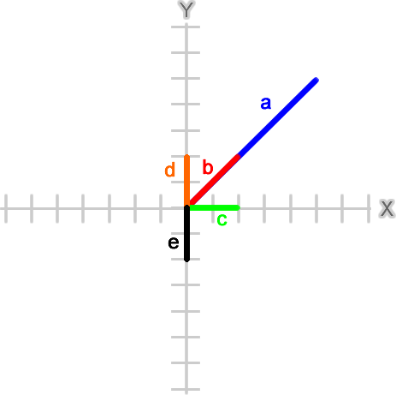
3D Math
Vector3.Dot(Vector3.Normalize(a),
Vector3.Normalize(b))
1.0
Vector3.Dot(Vector3.Normalize(d),
Vector3.Normalize(e))
-1.0
Vector3.Dot(Vector3.Normalize(c),
Vector3.Normalize(d))
0.0
Vector3.Dot(Vector3.Normalize(b),
Vector3.Normalize(c))
0.707106769
Vector3.Dot(Vector3.Normalize(b),
Vector3.Normalize(e))
-0.707106769
Notes:
http://www.flickr.com/photos/rutty/492385781/
Unit vectors – length = 1
Normalize creates a unit vector
Dot product *describes* the angle of two vectors, if normalized will be between -1 and 1
1 = parallel, same direction
-1 = parallel opposite direction
0 = right angle
Sign also means (+) acute or (-) obtuse

Slide 12
3D Math
Math.Acos(
Vector3.Dot(Vector3.Normalize(b),
Vector3.Normalize(c)))
0.78539818051171917
Math.Acos(
Vector3.Dot(Vector3.Normalize(b),
Vector3.Normalize(e)))
2.3561944730780739
Math.Acos(
Vector3.Dot(Vector3.Normalize(b),
Vector3.Normalize(d)))
0.78539818051171917
Math.Acos(
Vector3.Dot(Vector3.Normalize(b),
Vector3.Normalize(c)))
0.78539818051171917
Notes:
http://www.flickr.com/photos/rutty/492385781/
Arc cosine converts a dot product to an angle
Dot products describe the angle, but not the direction – d and c are on opposite sides, yet have the same angle…

Slide 13
3D Math
Vector3.Cross(b, d)
{X:0 Y:0 Z:4}
Vector3.Cross(b, c)
{X:0 Y:0 Z:-4}
Math.Acos(
Vector3.Dot(Vector3.Normalize(b),
Vector3.Normalize(c)))
* Math.Sign(Vector3.Cross(b, c).Z)
-0.78539818051171917
Notes:
http://www.flickr.com/photos/rutty/492385781/
Cross product calculates a vector perpendicular to the two vectors given, using them to describe a plane, also called a normal (not the same as a normalized vector).
Normals used by 3D engine to determine the front, and also the direction lighting should reflect.
Cross product also gives a negative or positive value, which can be applied to the angle to have the full picture
The last example is the angle to rotate turret b to face player c

Slide 14
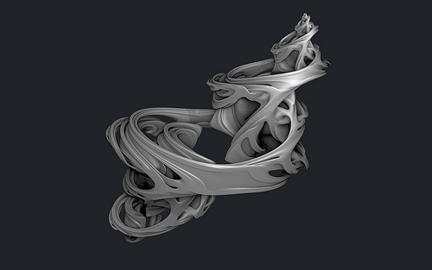
3D Math
Quaternions
Notes:
http://www.flickr.com/photos/subblue/3941924561/
Rotation around an axis
Matrix.CreateFromAxisAngle to create
Vector3.Transform to use
(can cheat on everything above!)

Slide 15

Show Me The Code!

